Slide 1
I-280 Corridor Study and
I-280/Winchester Blvd Project
Winchester Neighborhood Action Coalition
April 20, 2016

Slide 2
Outline of Presentation
Introductions
I-280 Corridor Study
I-280/Winchester Blvd Project
Input

Slide 3
Questions to us about I-280 from WNAC
What has taken place with regards to the 280 exit from 280 N to Winchester?
What costs have been estimated to date?
What is the time frame?
What planning has been done?
What public engagement has happened?
What benefits to the City are expected?
What traffic flow is expected with the ramp (e.g., How many cars per hour are expected? How many cars per hour maximum can it handle? etc.)?
Where will funding come from?
Who leads this effort?
What would the expected start date be?
Captured fees from development that can be applied in certain areas. Who makes the decisions on how they get used? (Voluntary Contributions)

Slide 4
I-280 Corridor Study

Slide 5
I-280 Corridor Study - Background
Study of highway corridor – history of other studies
I-280 from US 101 in San Jose to San Mateo County Line
  High level assessment of what can be improved
  Identification of improvement options
  Look at all modes; take input from other ongoing studies
  Involves local cities/towns, County, Caltrans and other public agencies
  Sketch concepts; this is work prior to project specific work
I-680 Corridor Study as a recent example
  Study of I-680 in Milpitas and San Jose
  Crowdsourcing application:
Countywide transportation planning process

Slide 6
I-280 Corridor Study – Part of Larger Process
Construction
Local Agency Land Use Planning, Development and Implementation
Coordination with
Other Projects
Project Development
Final Design
Environmental Clearance
Initiate Project with Caltrans
Alternatives Analysis
Regional/Countywide Transportation Plan
Corridor Studies
Highway Improvements like I-280/Winchester Blvd

Slide 7
I-280 Corridor Study – Work Plan/Timeline
Final Report
Spring 2017
January /
February 2016
March through
July 2016
August /
September 2016
October through
March 2017
Begin Study
(Scope & Schedule)
Data Collection & Initial Assessments
Community Meetings
Final Assessments
Develop Projects
Collect Data & Develop Improvement Concepts
Two Community Meetings
&
Customized
Interactive Maps
to Gather Input
Input for Countywide Planning and Feedback for Other Efforts
What Happens Next?

Slide 8
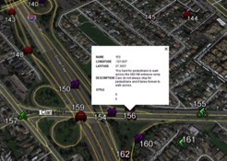
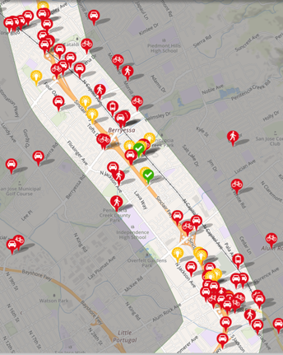
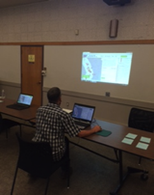
Crowdsourcing Outreach – I-680 Study Example
CrowdSpot application
510 Unique responses
Site open for one month
http://i-680corridorstudy.crowdspotmap.com/page/welcome

Slide 9
I-280 Corridor Study – Early Input Today
Provide early input for all modes and locations in corridor
Share Improvement Idea or Suggestion (Yellow)
  Add bike lane, add wider sidewalk, provide more frequent bus service, extend carpool lane, add lane to roadway, remove lane from roadway, etc.
Identify Transportation Issue (Pink)
  Long delays at STOP sign, traffic signals not well timed, vehicles on freeway ramps spilling back onto local roadway, bike lane does not exist, private shuttles affecting traffic, pothole in roadway, signal green times are too long, etc.

Slide 10
I-280/Winchester Blvd Project

Slide 11
I-280/Winchester Blvd Project – Background
Reasons for improvement:
  Lack of access into the Stevens Creek Blvd/Winchester Blvd area
  Existing use of available roadway space and demands not matching
  Need for improved connectivity and facilities for bicyclists and peds
  New land uses being planned for the area
Funding Sources:
  City of San Jose
  Metropolitan Transportation Commission
  VTA
Revisit area with a clean slate.
  Identify area for study/improvement
  Identify how area can be improved
  Collaborate with community and stakeholders
Notes:
Traffic volumes due to:
2 large retail centers
Winchester Mystery House
Residential and other commercial retail businesses
Proposed Urban Villages
Santa Clara Valley Medical Center
Stevens Creek Auto Row
O’Connor Hospital

Slide 12
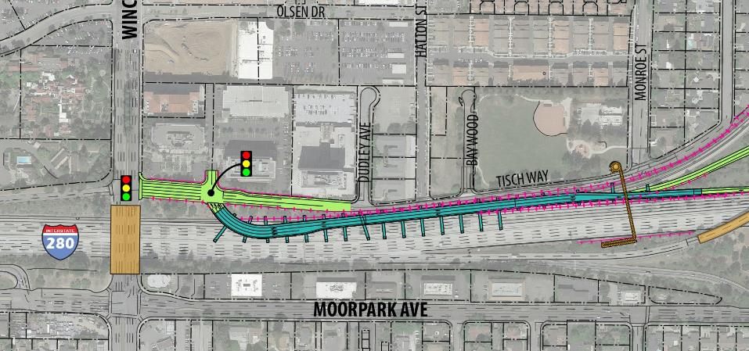
I-280/Winchester Blvd – Background
Previously studied: Hook Ramp Alternative

Slide 13
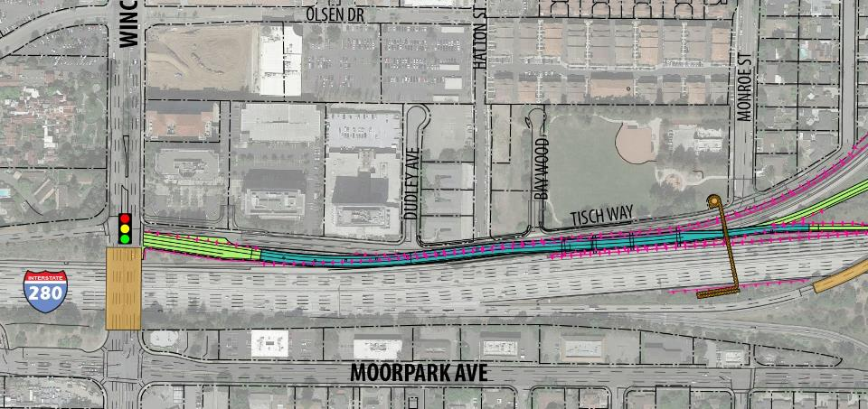
I-280/Winchester Blvd – Background
Previously studied: 5-Legged Intersection

Slide 14
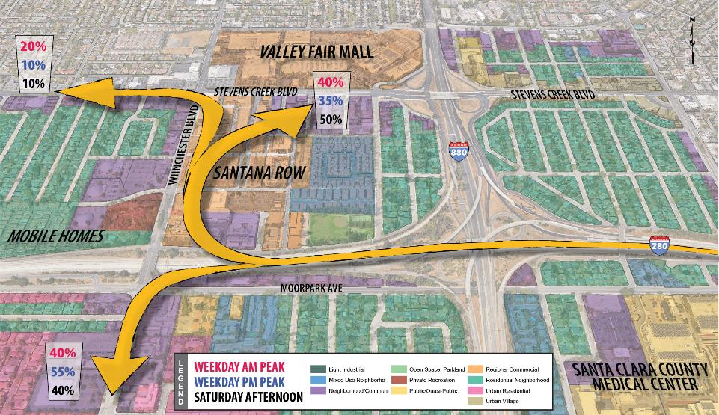
I-280/Winchester Blvd – Traffic Flow
[what we are trying to accomplish with project – maybe we show traffic flow diagrams from MTCo here?]

Slide 15
I-280 Winchester Blvd – Work Plan/Timeline
June 2016 through
August 2016
Complete Study
Spring 2017
May 2016
May 2016
June 2016
August 2016
Initiate Project
Data Collection
Assessment of Existing Issues
Alternatives Development
Final Report
Initiate Project
Community Input
Review Alternatives with Community
Next Steps
Identify Funding for Project Development Phases

Slide 16
I-280/Winchester Blvd – Next Steps
Finalizing contract with consultant team
Initiate data collection and assessment of existing conditions/issues
Schedule meetings for community input

Slide 17
Thank you
Casey Emoto
casey.emoto@vta.org

